Slide 1
BIGTECHCOMPANY
Financial Overview

Slide 2
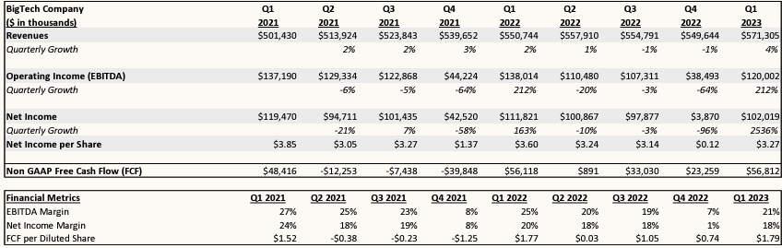
QUARTERLY PERFORMANCE
Insert Quarterly table (Output 1) in this space.
Delete this box once this is completed.

Slide 3
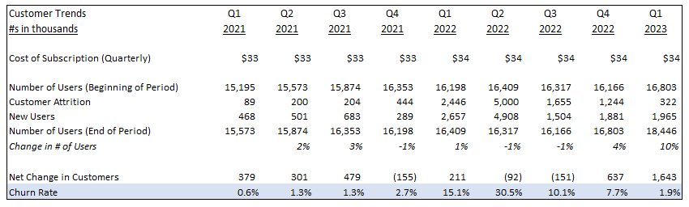
CUSTOMER TRENDS
Key Takeaways:
Big Tech Company increased its subscription cost in Q1 2022.
This led to a spike in the number of customers canceling their services; however, the number of new users also increased during this time.
▪ While the company experienced an atypically high churn rate in Q2 2022, this has now decreased to the levels seen before the price increase.
Insert Customer Trends (Output 2) Here
Delete this box once this step is completed.

Slide 4
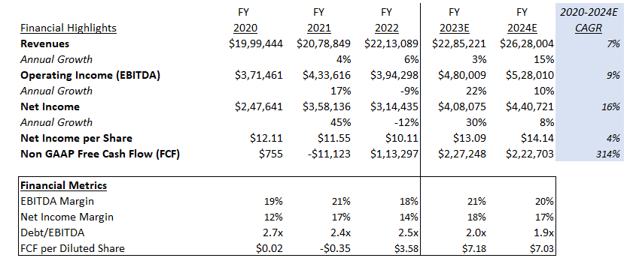
PROJECTIONS
Insert Output 3 in this space.
Delete this box once this is completed.

Slide 5
CONCLUSIONS
Company Highlights
Big Tech Company has seen steady revenue growth over the past two years and is expected to continue growing in the future.
The company is cash flow positive and will continue to be in the future.
The company’s debt/EBITDA is currently 2.4x and is expected to continue to decrease. This is low compared to the industry average of 4.0x, suggesting the company has a healthy leverage ratio.
Areas of Concern
The company has volatile quarterly expenses, particularly in the 4th quarter of each year.
The company’s EBITDA margin is low compared to the industry average of 39%.
Recommendation
We should develop a relationship with Big Tech Company, as they are continuing to grow and could be a valuable client in the future.
We should ask the company to clarify why expenses are higher in some quarters vs. others.
We should ask about the company’s plans to increase prices in the future, as this may lead to customer attrition.

